Slide 1
A GIFT OF FIRE THIRD EDITION - SARA BAASE
CHAPTER 2: Computer Crime
Lecture 2
Syada Tasmia Alvi
Lecturer, Dept.of CSE
Daffodil International University

Slide 2
Cyber Crimes
Cybercrime is any criminal activity that involves a computer, networked device or a network.
Cyber crime is a subset of computer crime.
Definitions :
Offences that are committed against individuals or group of individuals with a criminal motive
to intentionally harm the reputation of the victim or
cause physical or mental harm to the victim directly or indirectly, using modern telecommunication networks such a s internet.

Slide 3
TARGETS OF CYBER CRIMES
Against individual property
Transmitting virus
Un-authorized control/access over computer
Intellectual property crimes
Internet time thefts
Against Organization
Possession of un-authorized information
Cyber terrorism against the government organization
Distribution of pirated software,etc

Slide 4
TARGETS OF CYBER CRIMES
Against Social at Large
Pornography (basically child pornography)
Trafficking
Financial crimes
Online gambling
Forgery
Sale of illegal articles

Slide 5
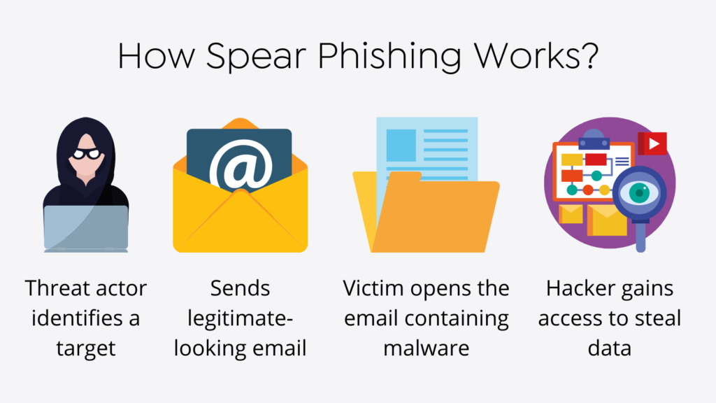
SOME COMMON CYBER CRIMES
Computer Virus: A computer virus is a computer program or attaches itself to application programs or other executable system software causing damage to the files.
Phishing: Phishing occurs when the perpetrator sends fictitious e-mails to individuals with links to fraudulent websites that appear official and thereby cause the victim to release personal information to the perpetrator.

Slide 6
SOME COMMON CYBER CRIMES
Hacking: The act of penetrating or gaining unauthorized access to or use of data unavailable in a computer system or a computer network for the purpose of gaining knowledge, stealing or making unauthorized use of the data.
Spoofing : Spoofing, as it pertains to cybersecurity, is when someone or something pretends to be something else in an attempt to gain our confidence, get access to our systems, steal data, steal money, or spread malware

Slide 7
SOME COMMON CYBER CRIMES
Netsplonage: Netsplonage occurs when perpetrators back into online systems or individual PCs to obtain confidential information for the purpose of selling it to other parties.
Cyber stalking: Cyber stalking refers to the use of the internet, email or other electronic communications device to stalk another person. It is an electronic harassment that involves harassing or threatening over a period of time.
Cyber Terrorism: Cyberterrorism is the convergence of cyberspace and terrorism. It refers to unlawful attacks and threats of attacks against computers, networks and the information stored therein when done to intimidate or coerce a government or its people in furtherance of political or social objectives.

Slide 8
MOTIVES OF CYBER CRIMINALS
Desire for entertainment
Profit
Infuriation or revenge
Political agenda
Sexual motivations
Psychiatric illness

Slide 9
PREVENTION
Use hard to guess passwords
Use anti-virus software and firewalls-keep them up to date
Don’t open email or attachments from unknown sources
Backup your data

Slide 10
Thank You

